Slide 1



TEST DRIVEN DEVELOPMENT
Anıl SelİM SÜRMELİ
_skynyrd
skynyrd

Slide 2

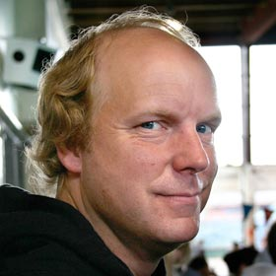
KENT BECK ’03 ‘’Rediscovery’’

Slide 3

TEST DRIVEN DEVELOPMENT
AGILE MANIFESTO
EXTREME PROGRAMMING

Slide 4
TDD
FAIL TO SUCCESS ???

Slide 5

WRITE A FAILING TEST!

Slide 6

IMPLEMENT

Slide 7

PASSED ???

Slide 8
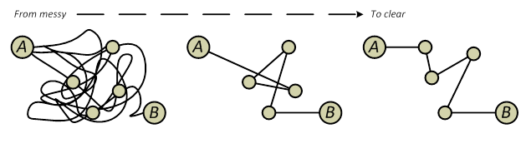
refactor

Slide 9
TDD
SEE RED
CODE
GET GREEN
REFACTOR

Slide 10

WHY

Slide 11
http://www.isixsigma.com/industries/software-it/defect-prevention-reducing-costs-and-enhancing-quality/

Slide 12
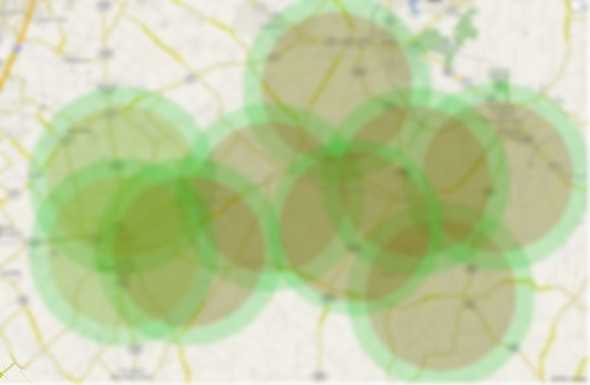
TEST COVERAGE

Slide 13
EASY EVOLUTION
&
ADAPTATION

Slide 14

BEST PRACTICES

Slide 15

TDD
BDD
CONTINIOUS INTEGRATION
AGILE FRAMEWORKS

Slide 16
TOOLS

Slide 17
Unit testing frameworks
[TestFixtureSetUp]
public void TestFixtureSetUp() {
result = SomeHelperClass.GetResult();
}
[Test]
public void the_result_should_be_true() {
result.Should.BeTrue();
}
EXAMPLES: NUNIT & SHOULDLY FOR .NET

Slide 18
Mocking libraries
public void Foo() {
var mockObject = new Mock<SampleClass>();
mockObject
.Setup(object => object.Bar())
.Returns(whatIWantForTest);
}
EXAMPLE: moq FOR .NET

Slide 19
LET’S DIVE IN…

Slide 20

References
Martin Fowler articles
http://martinfowler.com/bliki/TestDrivenDevelopment.html
http://martinfowler.com/articles/is-tdd-dead/
Kent beck’s BOOk
http://www.eecs.yorku.ca/course_archive/2003-04/W/3311/sectionM/case_studies/money/KentBeck_TDD_byexample.pdf
Hepsiburada team
https://github.com/hepsiburada

